Slide 1

Lessons learned on high-performance computing
on GPUs: a practical introduction to CUDA
Sebastiaan van Paasen

Slide 2
Content
Introduction to parallel computing
GPU computing explained
Brief introduction of the test case
Break
Optimization #1: understanding the memory
Optimization #2: decoupling of the specific problem on the GPU
Optimization #3: extract problem specific benefits
Optimization #4: reducing idle GPU time
Main take aways
4-7-2023

Slide 3






Content
Investigating an FEA simulation
Typically, Central Processing Units (CPUs) are used
CPUs perform a single task at a time
Introduction to parallel computing
GPU computing explained
Brief introduction of the test case
Problem:
Large computational workload
→ Long simulation time
Solution:
Compute each element simultaneously
→ Parallel computing
→ CPU cluster
4-7-2023
3

Slide 4
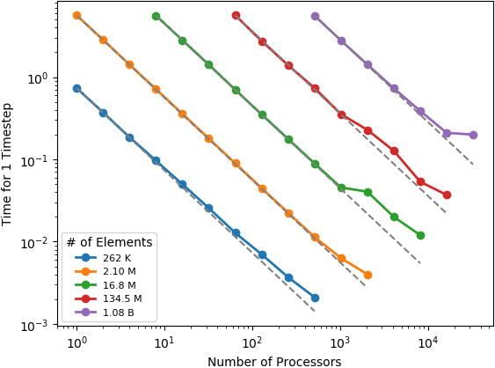











Content
Parallel computing with CPUs
Introduction to parallel computing
GPU computing explained
Brief introduction of the test case
4x
6x
Problem:
Communication between CPU
→ Performance saturates
Solution:
Use GPUs for parallel computing
- Slow for a single task
+ Thousands of tasks in parallel
- Difficult to use efficiently
+ Act as co-accelerator
4-7-2023
4

Slide 5

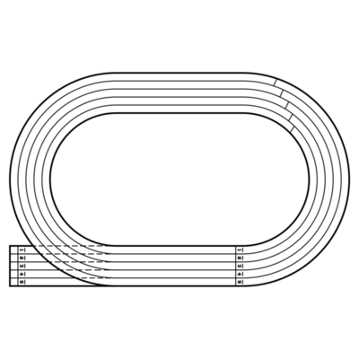



Content
Parallel computing with a GPU
What did the CPU do again?
CPUs perform a single task at a time
Introduction to parallel computing
GPU computing explained
Brief introduction of the test case
= single CPU performing task
→ 4 laps in a single lane (relay)
How does the GPU handle this?
GPUs perform many tasks at a time
each task is performed by a unique thread
= unique thread performing a task
→ 1 lap using all lanes
4-7-2023
5

Slide 6
Content
GPU Programming with CUDA
Introduction to CUDA
Introduction to parallel computing
GPU computing explained
Brief introduction of the test case
API developed by NVIDIA
Written in C++, available via Python/Matlab as well
Why is C++ recommended?
Direct control over GPU usage
Offers most simple use of all different GPU functionalities
4-7-2023
6

Slide 7

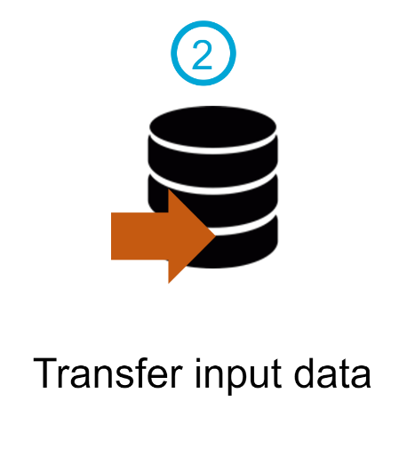

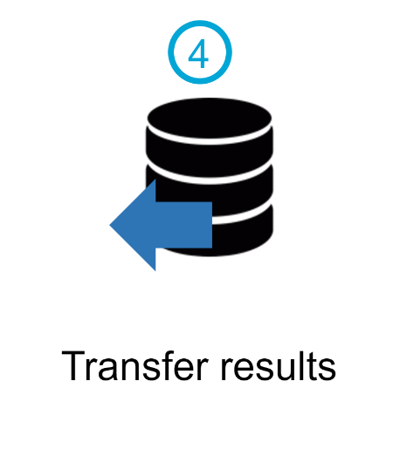
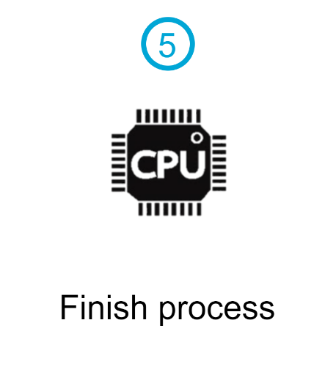



Content
Computing process with a GPU
Acts as a co-accelerator along a CPU
Introduction to parallel computing
GPU computing explained
Brief introduction of the test case
4-7-2023
7

Slide 8

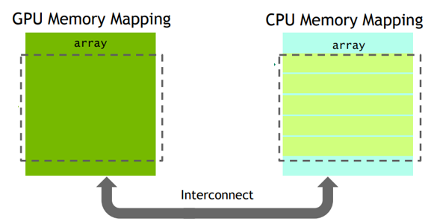
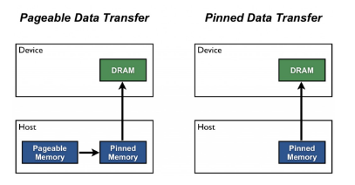
Content
Interaction between CPU and GPU
Introduction
Research scope
Model-agnostic optimization
Model-specific optimization
Conclusion
Recommendations
Memory transfers happen via the PCI-bus
GPU offers different memory types, each with its own benefits and drawbacks
Unified memory
Easiest form for novel users
Allocation only happens once
Not optimal in terms of performance
Pinned/Paged memory
Explicit memory transfers from CPU to GPU
Allocation on both CPU and PGU
Yields best performance
4-7-2023
8

Slide 9

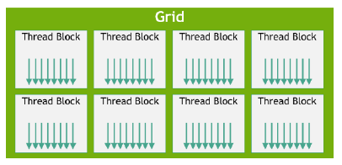
Content
Computing on the GPU
What is a thread?
Introduction to parallel computing
GPU computing explained
Brief introduction of the test case
Single thread: smallest unit on a GPU that performs a task
Threads have an execution hierarchy
Thread block: collection of threads up to1024
Grid: collection of threads blocks, all threads in a grid perform the same operation
4-7-2023
9

Slide 10
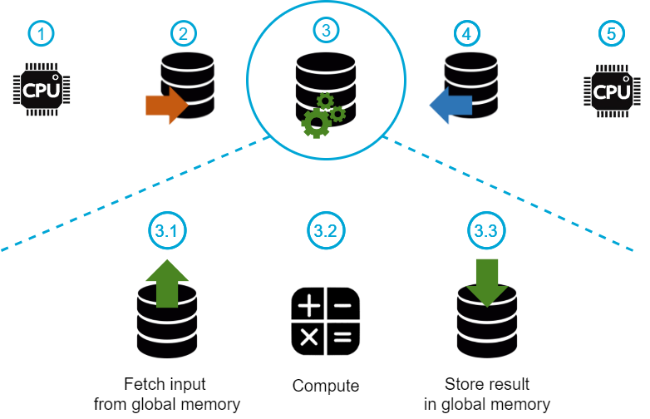
Content
Computing event on the GPU
What exactly happens on the GPU
Introduction to parallel computing
GPU computing explained
Brief introduction of the test case
4-7-2023
10

Slide 11
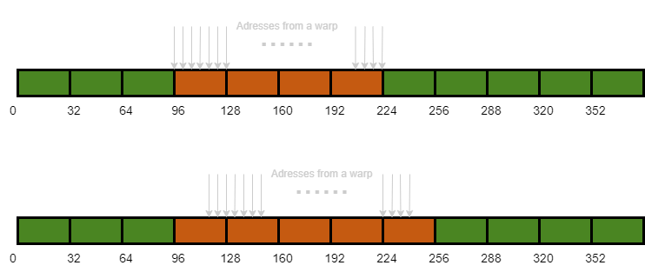
Content
Memory coalescence
Why keeping track of memory is important
Introduction to parallel computing
GPU computing explained
Brief introduction of the test case
Fetching memory happens per warp (32 threads)
Example: each thread needs to fetch a float value (4 bytes)
4-7-2023
11

Slide 12
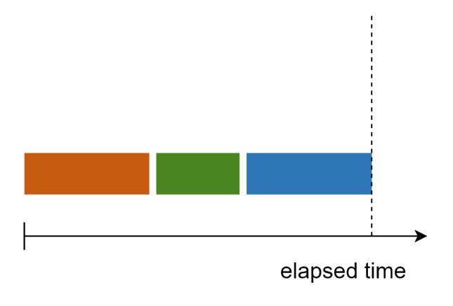
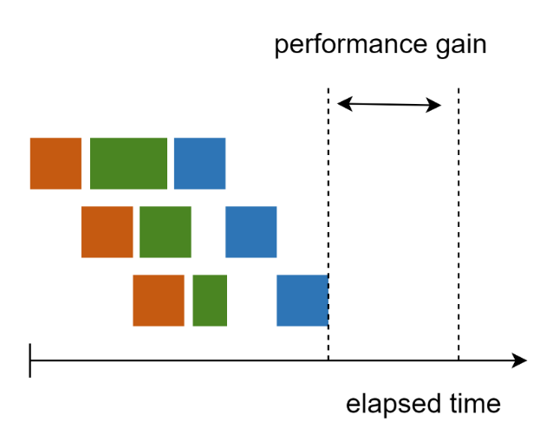
Content
Event scheduling
How to structure events efficiently
Introduction to parallel computing
GPU computing explained
Brief introduction of the test case
If all events occur sequentially a time schematic looks like:
Overlap can be created by using streams:
Requires decoupling of the problem
4-7-2023
12

Slide 13
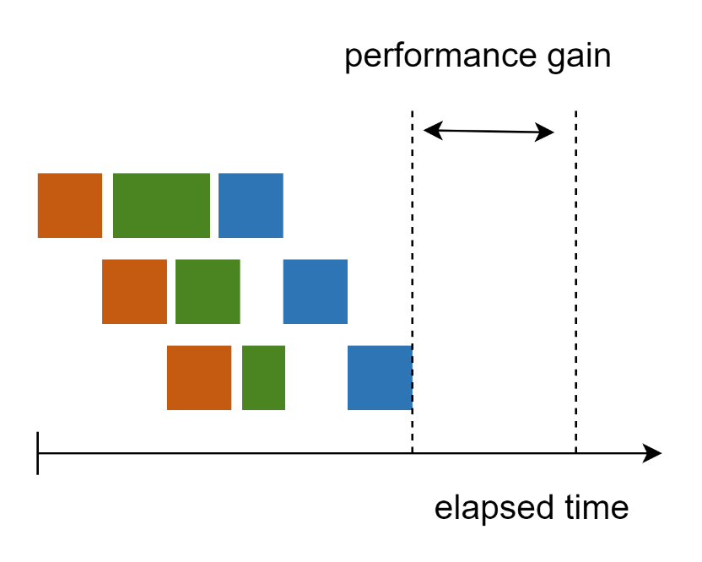
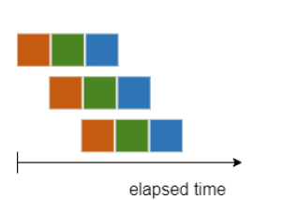
Content
Influence of the computation
Introduction to parallel computing
GPU computing explained
Brief introduction of the test case
Threads operate according to the SIMT principle in warps (groups of 32 threads)
Single Instruction Multiple Tasks principle
a thread can only start a new task once all threads finish their current task
= unique thread performing a task
= idle GPU time
4-7-2023
13

Slide 14
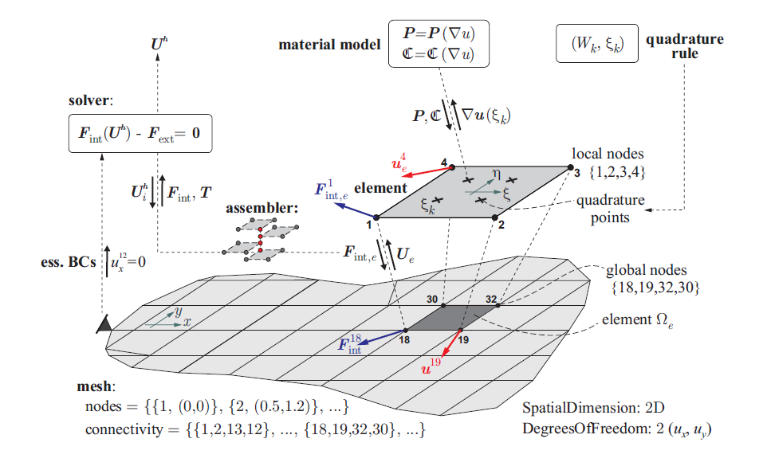
Content
Introducing the test case
Where to apply in FEA?
2.
Introduction to parallel computing
GPU computing explained
Brief introduction of the test case
4.
3.
Figure credits: D. Kochmann 2017
Construct shape functions
Computing elementary contributions
Assemble the global system
Solving the global system
4-7-2023
14

Slide 15
Break

Slide 16



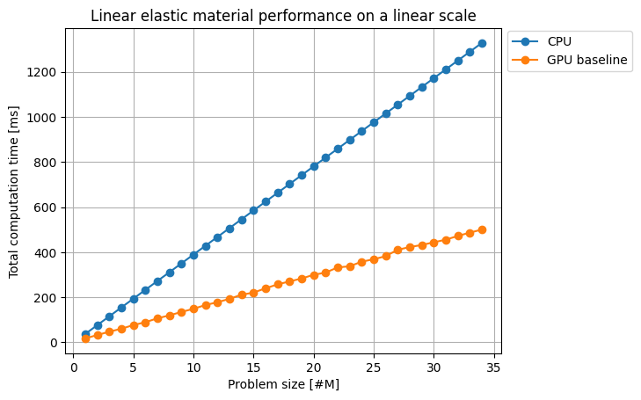
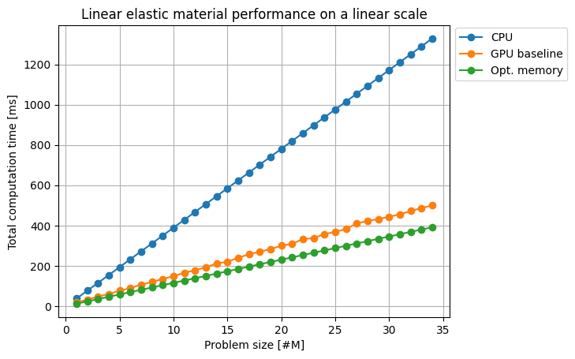
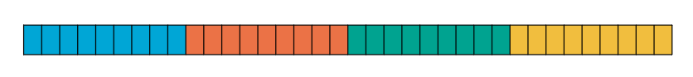

Content
The importance of memory (layout)
+
+
Starting from the baseline
Implementation | Total computation speed-up
GPU baseline | 2.90x
Opt. memory | 3.43x
Implementation | Total computation speed-up
GPU baseline | 2.90x
Optimization #1: understanding the memory
Optimization #2: decoupling the problem
Optimization #3: extract problem specific benefits
Optimization #4: reducing idle GPU time
Main take aways
Baseline implementation uses:
Unified memory
Strided memory layout
To optimize memory we change this to:
Pinned memory
Coalesced memory layout
F₁₁
F₁₂
F₁₃
F₂₁
F₂₂
F₂₃
F₃₁
F₃₂
F₃₃
4-7-2023
16

Slide 17
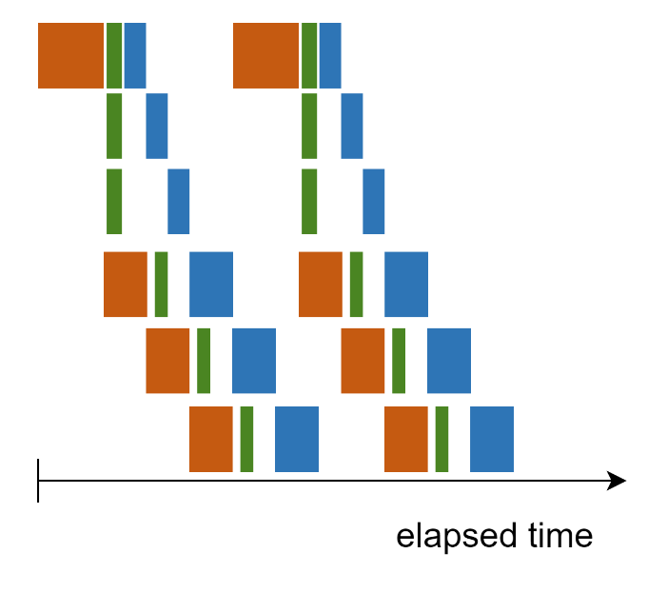

Content
Using the stream functionality
Through investigating the constitutive equation
Optimization #1: understanding the memory
Optimization #2: decoupling the problem
Optimization #3: extract problem specific benefits
Main take aways
σ = λ(tr ε)I + 2με
σ₁₁
σ₁₂
σ₁₃
ε₁₁
ε₁₂
ε₁₃
σ₂₁
σ₂₂
σ₂₃
ε₂₁
ε₂₂
ε₂₃
σ₃₁
σ₃₂
σ₃₃
ε₃₁
ε₃₂
ε₃₃
4-7-2023

Slide 18
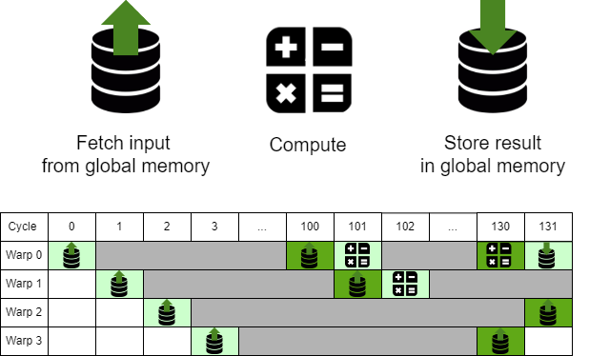
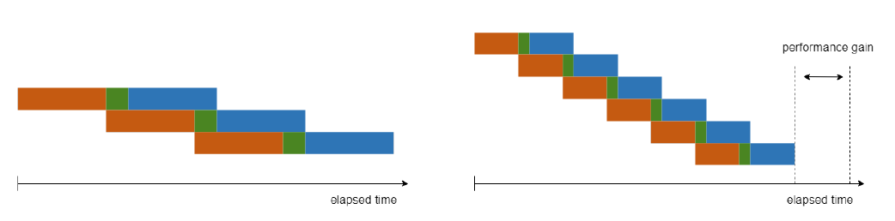
Content
Brief explanation of the principle
Investigating the computation execution of a warp (32 threads)
Optimization #1: understanding the memory
Optimization #2: decoupling the problem
Optimization #3: extract problem specific benefits
Main take aways
4-7-2023

Slide 19
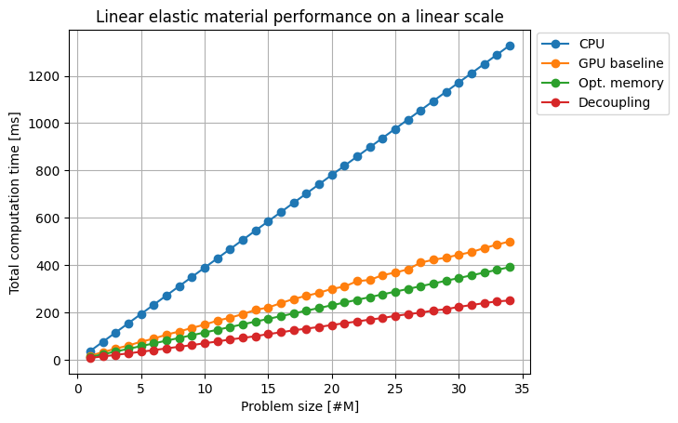
Content
Applying the decoupling
+
+
Implementation | Total computation speed-up
GPU baseline | 2.90x
Opt. memory | 3.43x
Decoupling | 5.55x
Implementation | Total computation speed-up
GPU baseline | 2.90x
Opt. memory | 3.43x
Implementation | Total computation speed-up
GPU baseline | 2.90x
Optimization #1: understanding the memory
Optimization #2: decoupling the problem
Optimization #3: extract problem specific benefits
Main take aways
4-7-2023

Slide 20
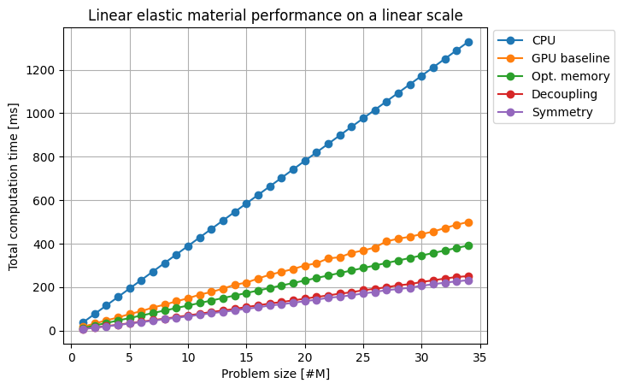
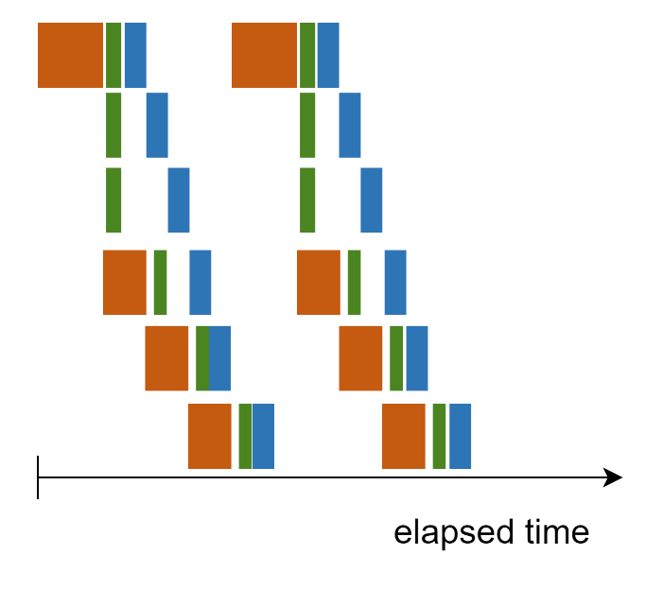
Content
Benefits from the linear elastic material
+
+
Utilizing symmetry
Implementation | Total computation speed-up
GPU baseline | 2.90x
Opt. memory | 3.43x
Decoupling | 5.55x
Implementation | Total computation speed-up
GPU baseline | 2.90x
Opt. memory | 3.43x
Decoupling | 5.55x
Symmetry | 5.76x
Optimization #1: understanding the memory
Optimization #2: decoupling the problem
Optimization #3: extract problem specific benefits
Main take aways
σ = λ(tr ε)I + 2με
σ₁₁
σ₁₂
σ₁₃
σ₂₁
σ₂₂
σ₂₃
σ₃₁
σ₃₂
σ₃₃
4-7-2023

Slide 21
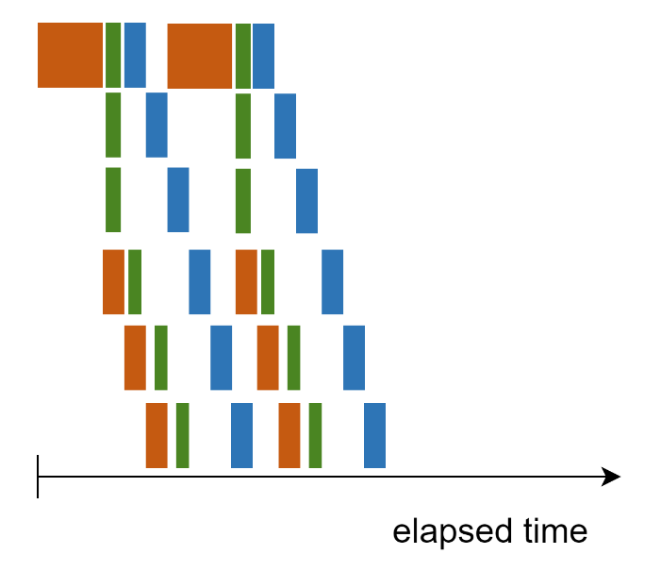

Content
Benefits from the linear elastic material
+
+
Utilizing double symmetry
Implementation | Total computation speed-up
GPU baseline | 2.90x
Opt. memory | 3.43x
Decoupling | 5.55x
Implementation | Total computation speed-up
GPU baseline | 2.90x
Opt. memory | 3.43x
Decoupling | 5.55x
Symmetry | 5.76x
Symmetry 2x | 4.55x
Implementation | Total computation speed-up
GPU baseline | 2.90x
Opt. memory | 3.43x
Decoupling | 5.55x
Symmetry | 5.76x
Optimization #1: understanding the memory
Optimization #2: decoupling the problem
Optimization #3: extract problem specific benefits
Main take aways
σ = λ(tr ε)I + 2με
ε₁₁
ε₁₂
ε₁₃
ε₂₁
ε₂₂
ε₂₃
ε₃₁
ε₃₂
ε₃₃
+
+
+
4-7-2023

Slide 22
Content
Lessons learned
Optimization #1: understanding the memory
Optimization #2: decoupling the problem
Optimization #3: extract problem specific benefits
Optimization #4: reducing idle GPU time
Main take aways
GPU theory has been explained
Utilizing even a simple GPU-implementation can result in a significant speed-up
The optimal implementation overlaps calculations and memory transfers
Depends on the amount of coupling of the specific problem
Extracts problem specific benefits
4-7-2023

Slide 23
Thank you for your attention!
Sebastiaan van Paasen

